Slide 1
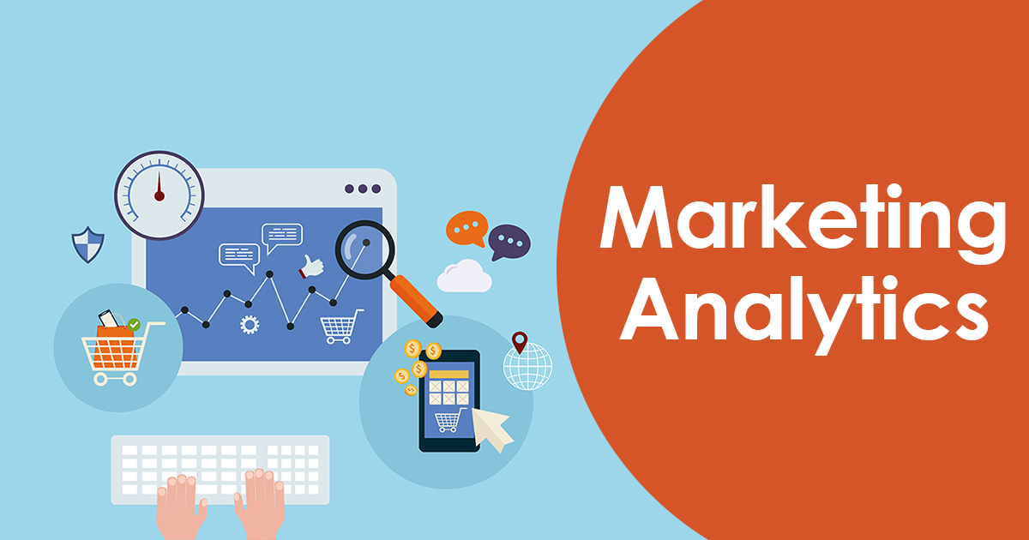
Lecture 5
Marketing Analytics

Slide 2
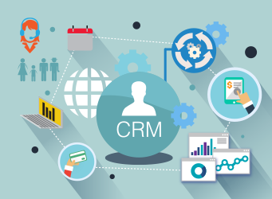
CRM: A Key Decision Tool for Marketers
Customer relationship management (CRM) involves systematic tracking of consumers preferences and behaviors over time in order to tailor individualized value propositions.
Allows firms to get “up close and personal”
A process by which firms enact their customer orientation
Capture information at each customer touchpoint

Slide 3

CRM Facilitates One-to-One Marketing
One-to-one marketing includes several steps
Identify customers and get to know them in as much detail as possible.
Differentiate among these customers in terms of both their needs and their value to the company.
Interact with customers and find ways to improve cost efficiency and the effectiveness of the interaction.
Customize some aspect of goods or services offered to each customer.

Slide 4
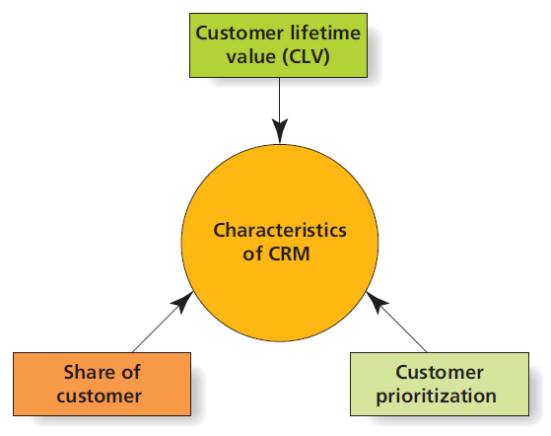
Customer-Related Metrics

Slide 5
Share of Customer
Its easier and less expensive to keep a current customer than it is to acquire a new one.
Many firms look to increase share of customer, instead of share of market.
Share of customer is the percentage of a given customer’s purchases in a category over time.
Enables company to grow sales and profits at a lower cost, relative to new customer acquisition.
I.e., if Amazon’s database records indicate that a given customer bought 3 books by a certain author, the CRM aspect of this system would try to increase share of customer by automatically sending an email to that individual offering him or her the opportunity to pre-order a new book which has been written by the author, but not yet released.

Slide 6

Customer Equity and Lifetime Value
Lifetime value of a customer is how much profit a firm will make on a customer.
Customer equity is financial value of a customer relationship.
Takes into account monetary investments to acquire and maintain relationship

Slide 7

Customer Prioritization
Not all customers are equal … at least, not in terms of profitability!
CRM systems enable marketers to identify priority customers and customize communications and special offers accordingly.
I.e., a firm may emphasize personal selling for contacting high-volume customers, while using direct mail or telemarketing to communicate to low-volume customers.

Slide 8


Transforming Customers into Corporate Assets
CRM leverages database technologies to customize customer interactions based on:
Share of customer
Lifetime value (and Customer equity)
Customer prioritization
Are there limitations, or even dangers, to viewing customers as financial assets?

Slide 9
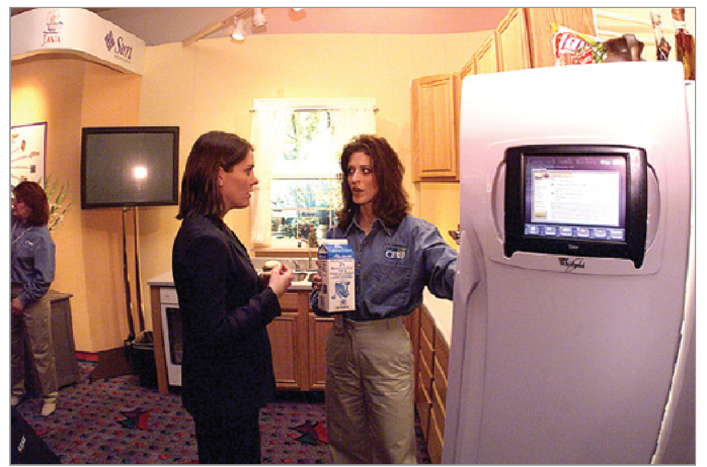
Big Data: Terabytes Rule
Big data is a popular term to describe the exponential growth of structured and unstructured data.
Internet data can be hard to analyze using traditional approaches.
Internet of Things
Notes:
The Internet of Things is a term that is increasingly used in articles and stories on technology trends to describe how everyday objects (e.g., cars and refrigerators) are connected to the Internet and in turn are able to communicate information throughout an interconnected system. Areas that would become part of this network include medical devices, cars, toys, video games—the list goes on and on.

Slide 10
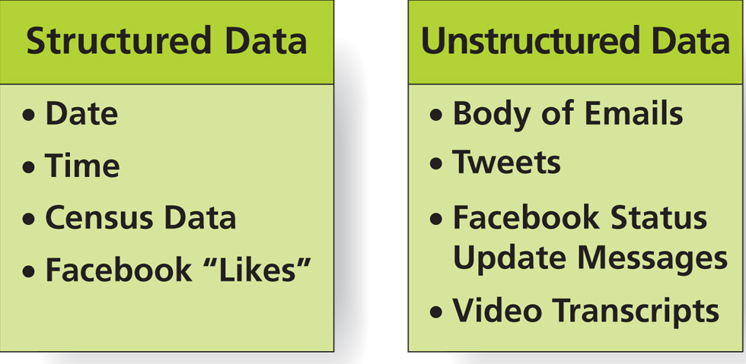
Structured and Unstructured Data Examples

Slide 11
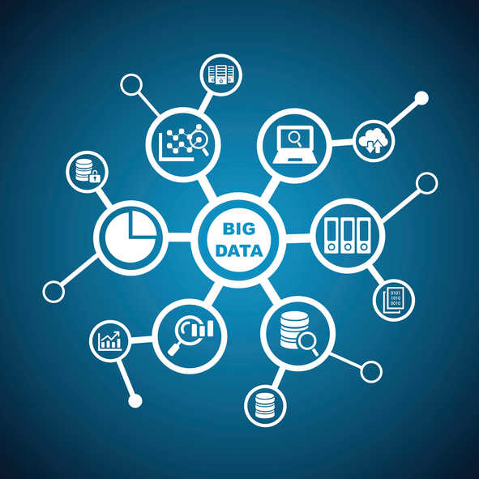
Insights from Big Data
Big Data can provide competitive advantages in three main areas:
Identifying new opportunities
Transforming insights into better products
Delivering timely information more efficiently and effectively

Slide 12
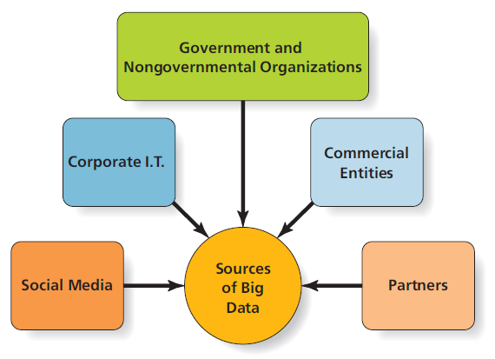
Sources of Big Data for Marketers

Slide 13

Data Mining
The biggest data challenge for many firms is determining what to do with it all!
Data mining refers to process by which analysts sift through Big Data to identify unique patters of behavior.
Data warehouses
Reality mining
Notes:
Reality mining is the collection and analysis of machine-sensed environmental data pertaining to human social behavior with the goal of identifying predictable patterns of behavior. Reality mining was declared to be one of the “10 technologies most likely to change the way we live” by Technology Review Magazine.

Slide 14




Ethical/Sustainable Decisions in the Real World
Software algorithms are a part of our daily lives.
Solid Gold Bomb t-shirt company used algorithms to modify British phrase, “Keep calm and carry on.”
Facebook may have selectively chosen which types of stories appeared in its “Trending Topics.”
Should social media companies who use algorithms to select news stories for display and distribution on their platforms be required to provide transparency into the inner workings of the related algorithms?

Slide 15
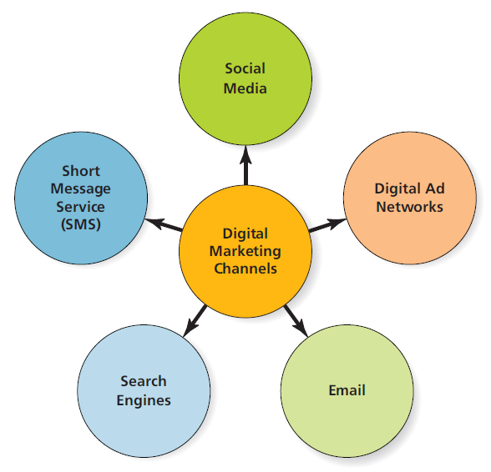
Marketing Analytics
Marketing analytics comprises of technologies and processes that enable marketers to collect, measure, analyze, and assess marketing effectiveness.
Predictive analytics use large quantities
of data to more accurately predict future
outcomes.
Major Digital Marketing Channels:
Notes:
Marketers have long faced challenges in determining campaign and channel effectiveness.
Digital marketing has become an increasingly important element of the marketer’s toolbox.
More and more people spending increasing time online
Much easier to track consumer behavior in response to digital marketing actions

Slide 16
Comparing Value of Digital Marketing Investments
Cost-per-click
Advertiser is charged only when user clicks on ad.
More expensive, requires greater interaction.
Cost-per-impression
Advertiser is charged each time ad shows up on user page.
Less expensive, but not as easy to measure.
Search engine optimization (SEO)
Compare average cost per customer transaction
Notes:
For marketers, investments in digital marketing are especially attractive because their cost is often directly tied to specific actions users take.
For instance, Google’s paid search ads can be purchased or bid on based on a cost per click in which the cost of the advertisement is charged only each time an individual clicks on the advertisement and is directed to the Web page that the marketer placed within the advertisement. This method of charging for advertisements is common for online vendors of advertisement space.
Other methods of purchasing advertisements digitally include cost per impression, in which the cost of the advertisement is charged each time the advertisement shows up on a page that the user views.
Companies that sell online advertising space commonly use both of these methods of charging for advertisements. Cost-per-click purchases of advertisements are typically more expensive, as they demand a higher level of interaction from the user. Cost-per-impression ad purchases can provide a good value. However, the cost-per-impression structure requires a greater leap of faith because it’s not so easy to measure the value of an impression (or view of an advertisement).
Search engine optimization is a systematic process to ensure that your firm comes up at or near the top of lists of typical search phrases related to your business (i.e., Google).
Once you’ve done all the calculations, you can compare the average cost per customer transaction.

Slide 17
Key Marketing Metrics
Click-through rate
(click-throughs /impressions) * 100
Conversion rate
# of goal achievements/# of website visitors
Cost per order
advertising costs/orders
Margin of sales
selling price per unit ($) - cost per unit ($)
Churn rate
(# of customers lost at end of prior period/# of customers at beginning of prior period) * 100

